Slide 1

Household Energy Consumption Prediction
Predicting Appliance Energy Usage in Homes
HUNTER ADRIAN
BROWN UNIVERSITY
OCTOBER 23, 2024
GITHUB REPOSITORY LINK

Slide 2
INTRODUCTION SLIDE
Goal: Predict household energy consumption using environmental and weather data to:
Reduce energy costs
Promote environmental benefits
Support smart technologies
Data Overview
Dataset: UCI Appliances Energy Prediction
Data Collected: 4.5 months in 10 minute intervals
Indoor Sensors: Temperature & humidity
External Weather Data: Temperature, humidity, and wind speed from a nearby airport

Slide 3
Exploratory Data Analysis

Slide 4
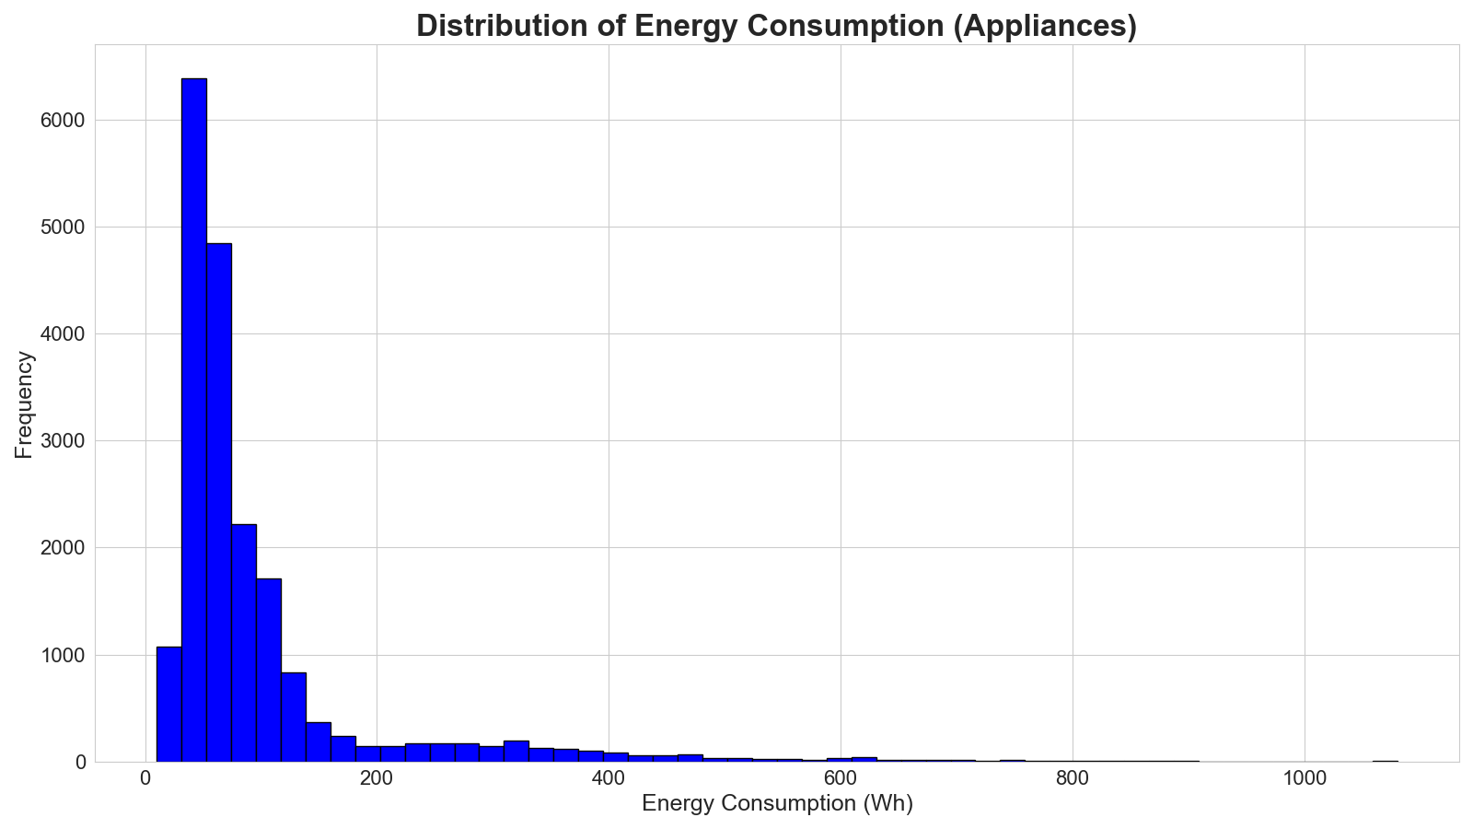

Slide 5
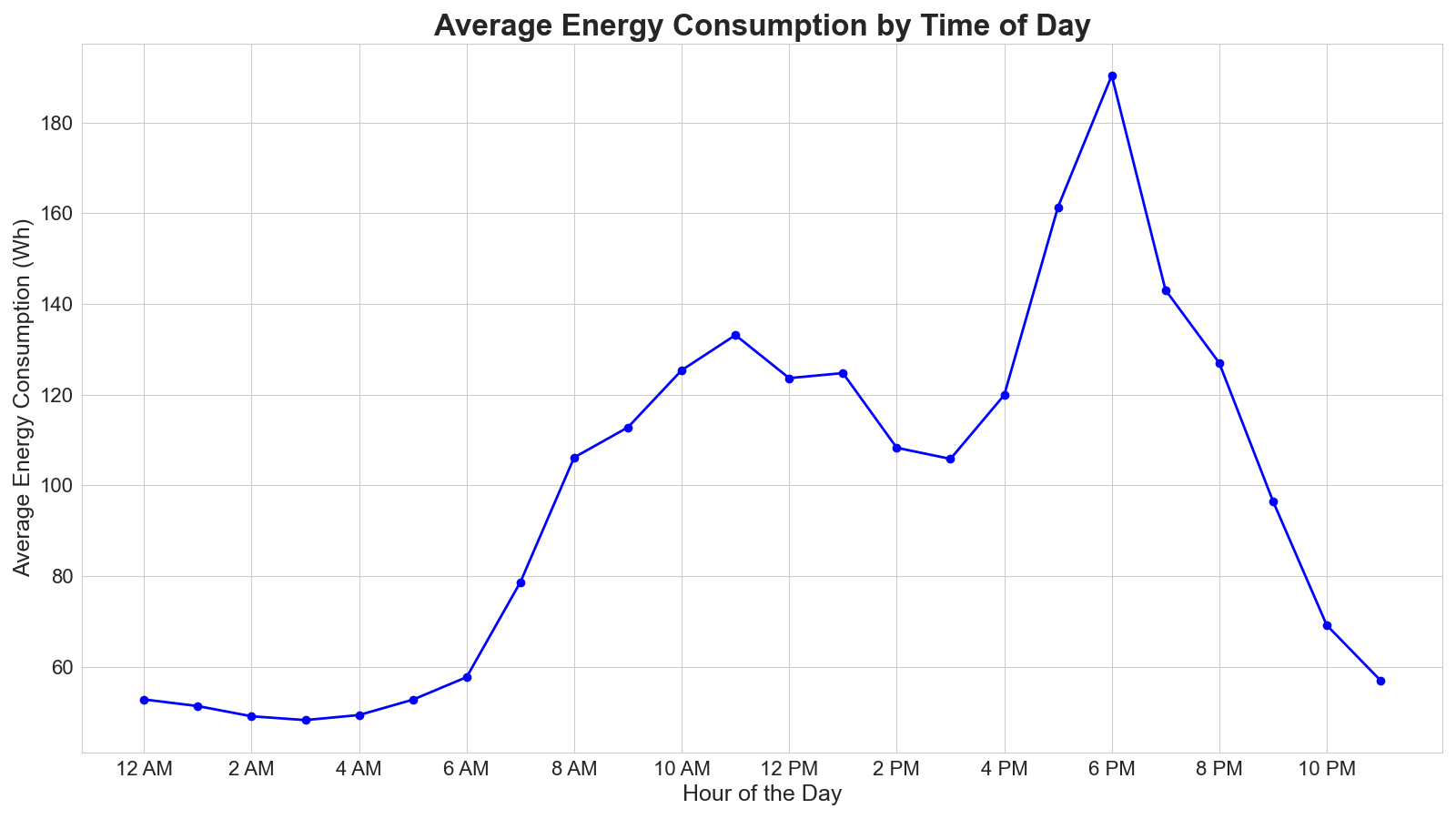

Slide 6
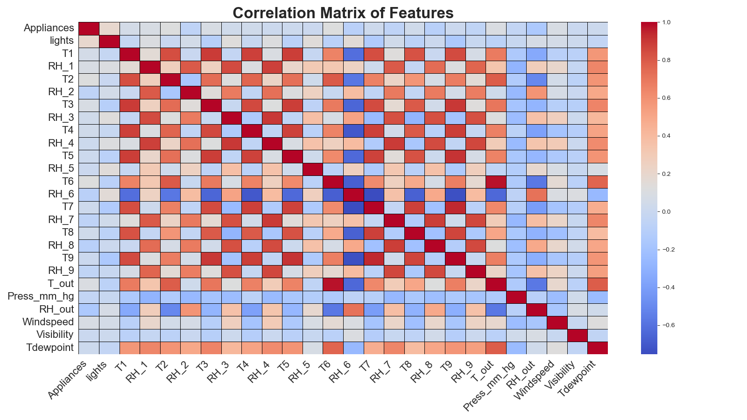

Slide 7
Spitting & Prepossessing

Slide 8
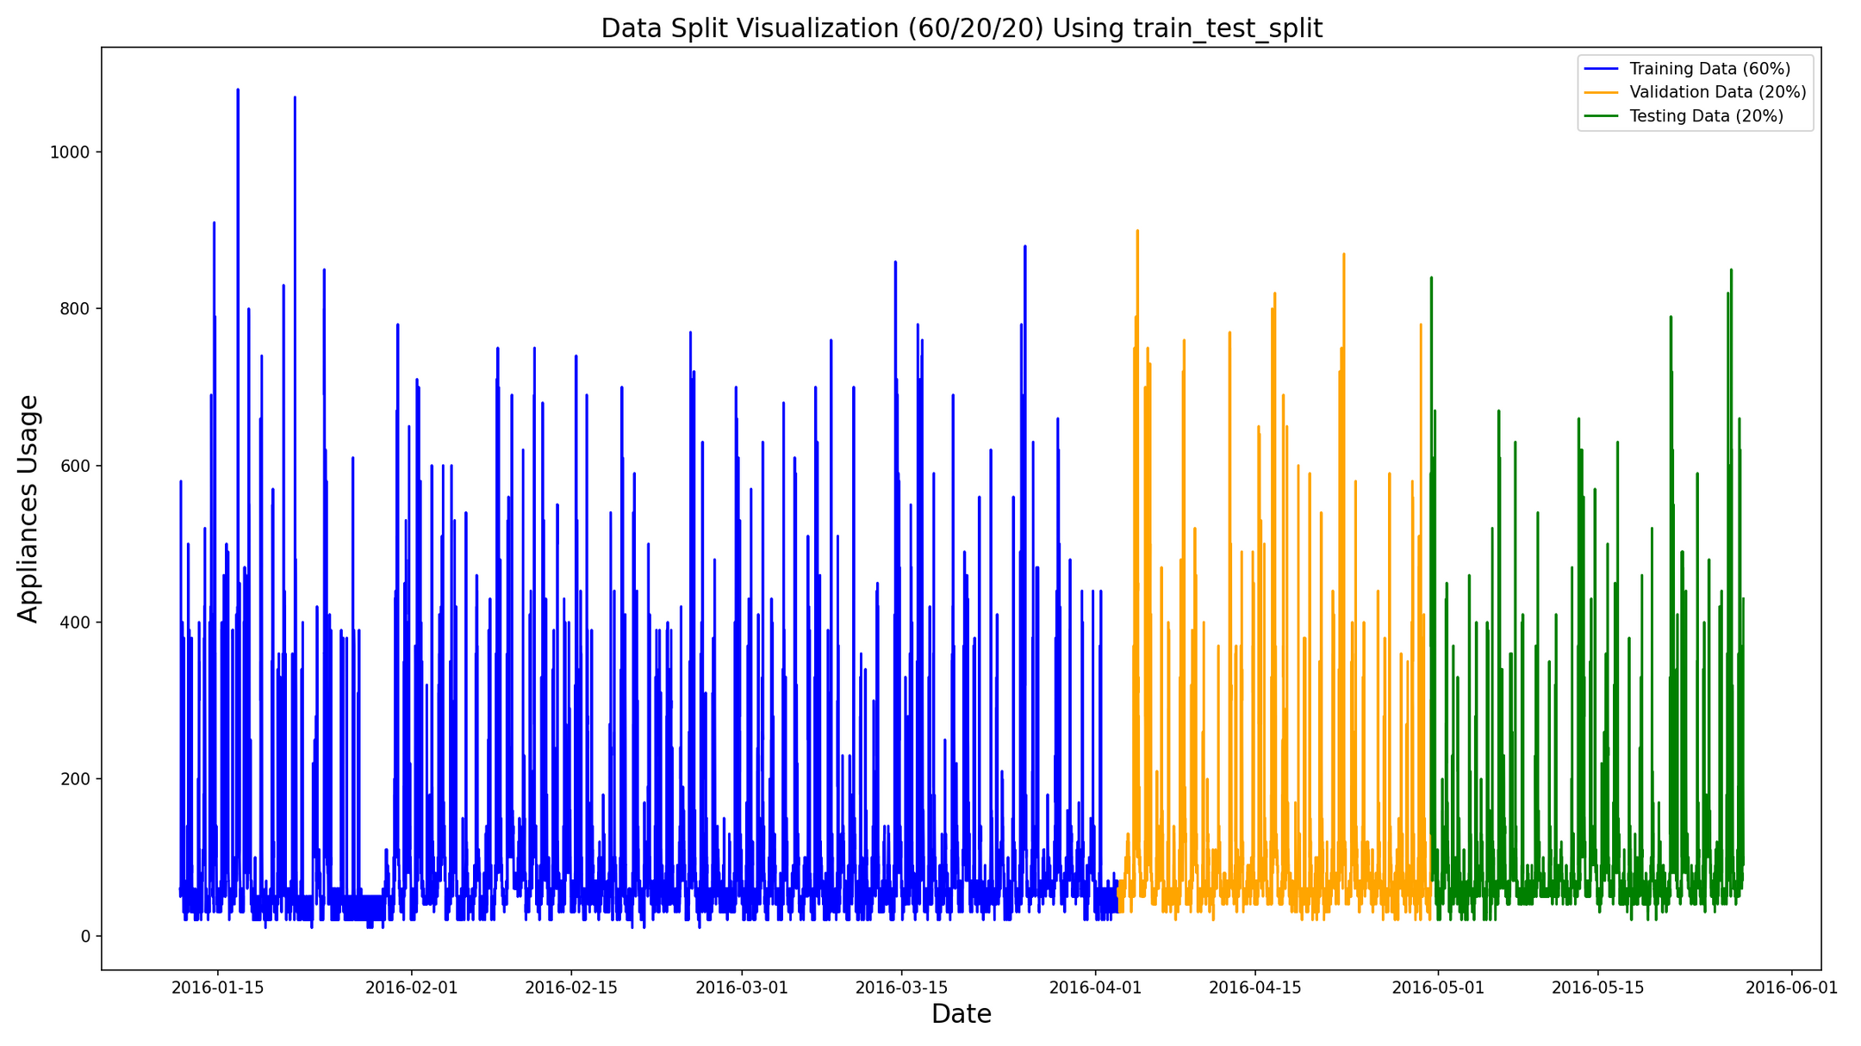

Slide 9
DATA SPLITTING AND PREPROCESSING:
Data Split:
Split the data into 60% training, 20% validation, and 20% test.
Maintained the chronological order.
Dataset:
Changed index to datetime format for time-series analysis.
No missing values or duplicates detected.
Scaling:
Applied StandardScaler for normalization.
Data Points:
27 features, 19,735 data points after preprocessing.

Slide 10
Questions?

